Slide 1
AMERICORPS CAPACITY-BUILDING OPPORTUNITY
Building Performance Association & Service Year Alliance
Notes:
Robin - Welcome

Slide 2
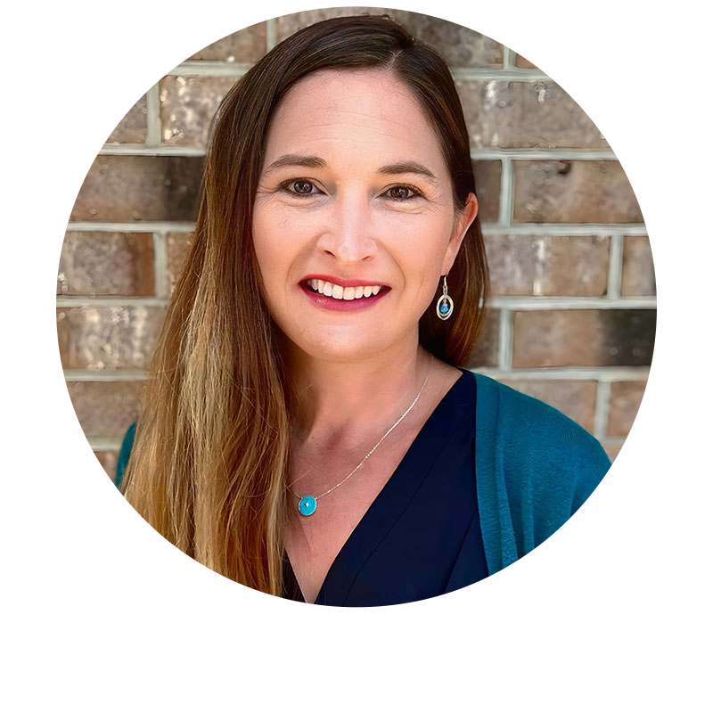
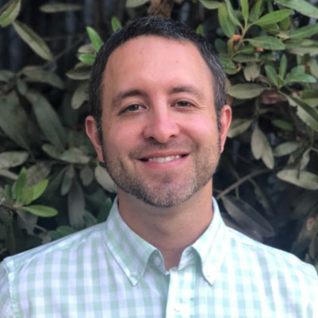
SPEAKERS
Xavier Walter
Director of Outreach
Building Performance Association
Brook Vernon
State Outreach Coordinator
Building Performance Association
Hailey Champagne
Maine AmeriCorps VISTA
Building Performance Association
Brent Kossick
Director, Programs
Service Year Alliance
2
Notes:
Robin - Speakers

Slide 3
The Building Performance Association (BPA) is a 501(c)6 industry association committed to redefining the industry through advocacy, careers, education, membership, and networking. BPA reaches more than 20,000 individuals and organizations working in contracting services, weatherization, product manufacturing and distribution, program administration, building science, government, and nonprofits.
Notes:
Brook

Slide 4
ENERGY EFFICIENCY WORKFORCE NEEDS
BPA NEEDS ASSESSMENT & STAKEHOLDER ENGAGEMENT
West Virginia, Maine, Delaware, Virginia and Kentucky
To identify strengths, challenges and needs in workforce development
Map the current energy efficiency workforce landscape
Provide implementation plans for workforce recommendations
“Boots on the Ground” involvement
BPA sponsors a Maine AmeriCorps VISTA for outreach & engagement
Pursuing AmeriCorps members in various states and nationally
ACE Network Partner for DOL Registered Apprenticeship Programs
Provide additional outreach support, technical assistance, and industry engagement in the development of “Energy Specialist” registered apprentices
4
Notes:
(Brook): BPA is actively engaged across the nation to identify the workforce needs within energy efficiency.

Slide 5
BPA GOAL: CREATE Clear Pathways FOR careers in energy efficiency
Expand Energy Specialist Registered Apprenticeships
Outreach in hard-to-reach communities
Exposure at K-12 level
Engagement with disadvantaged populations
Multiple channels for training opportunities
Connecting wrap-around services
Defining braided sources of funding
Wage progression & Hands-on skills
Ensuring equity, diversity and inclusion in career pathways
Notes:
(Brook): BPA’s goals are expansive, but these goals will help to ensure that energy efficiency careers become a household name. It requires developing clear paths from A to Z that are easy to access. It involves being diligent and creating lasting partnerships that value community. And must include a holistic approach when promoting energy efficiency careers. Outreach, exposure and education needs to be thoughtful and more than a piece of paper with information. It requires investment at the local level (and this is where AmeriCorps members are so crucial as you will soon hear). In addition to help engage communities, workers, and stakeholders in energy efficiency – BPA is defining state and federal sources that can help build workforce initiatives across the nation and is committed to supporting the energy efficiency workforce through advocating for wage progression, hands on training, and DEIA practices in the work place.

Slide 6
Objectives
Provide a high-level overview of AmeriCorps State/National Programming
Paint a picture of how AmeriCorps resources can be leveraged to help advance priorities areas for weatherization/clean energy stakeholders
Discuss opportunities to host AmeriCorps members through a national program that BPA hopes to launch in 2024
6
Notes:
(Brook): Our goals for today involve…(read slide)
- With that, I will hand the presentation over to Brent so that he can kick us off on our first objective.

Slide 7
To make a year of paid, full-time service — a service year — a common expectation and opportunity for all young Americans.
EXPANSION:
Build support from external stakeholders to make the recent expansions of national service successful in a new era.
RECRUITMENT:
Bring the next generation of youth into national service, modernize their experience using ServiceYear.org, and align the field around shared recruitment efforts and systems.
IMPACT:
Foster collaborative approaches to demonstrate the impact of service years by lifting up exemplary programs and communities.
7
Notes:
(Brent)
- Thanks. Just a quick high-level overview of Service Year Alliance…..

Slide 8
AmeriCorps State/Nation
AmeriCorps: A paid opportunity to develop real-world skills through hands-on service that seeks to address some of our nation’s greatest challenges
Win: Program participant or “corps member”
Win: Community being served
Win: The nation as a whole
There are between 65,000-85,000 AmeriCorps opportunities across the country that offer experiences of varying lengths of commitment, in different issue areas, and across different geographic regions
8
Notes:
(Brent)
Well over 1million Americans have served

Slide 9
AmeriCorps State/Nation
VISTA
- Capacity Building
- Fight Against Poverty
- 17yo+
- Full-Time
- Stipends/Benefits Administered by Federal Agency
NCCC
- Episodic Projects
- Broad Service Categories
- 17-24yo
- Full-Time
- Stipends/Benefits Administered by Federal Agency
Seniors
- Broad Service Categories
- 55yo+
- Primarily Part Time
- Stipends/Benefits Administered by Federal Agency
State/National
- Broad Service Categories
- 17yo+
- Part Time & Full-Time
- Administered through a Competitive Three-Year Grant
9
Notes:
(Brent)
- The are multiple branches of AmeriCorps - - I know that some of you have likely had some exposure to AmeriCorps, so want to provide some clarity around the branch that we will be discussing today.
- NCCC – Specialize in disaster response and environmental/conservation services
- Seniors – Specialize in tutoring/mentoring and aging in-place

Slide 10
AmeriCorps State/Nation
Seniors
- Broad Service Categories
- 55yo+
- Primarily Part Time
- Stipends/Benefits Administered by Federal Agency
State/National
- Broad Service Categories
- 17yo+
- Part Time & Full-Time
- Administered through a Competitive Three-Year Grant
VISTA
- Capacity Building
- Fight Against Poverty
- 17yo+
- Full-Time
- Stipends/Benefits Administered by Federal Agency
NCCC
- Episodic Projects
- Broad Service Categories
- 17-24yo
- Full-Time
- Stipends/Benefits Administered by Federal Agency
10
Notes:
(Brent)
- AmeriCorps State and national
Although 22 is probably most typical, ages can range very broadly.
Organizations receive grants that come with a match requirement – cover most program costs and administrative functions with support from grant and match resources – (i.e. payroll, benefits, project & training costs, etc.
Grant can cover staff support

Slide 11
AmeriCorps State/National
Recruitment
Applicants can choose where they would like to serve and the organization that they would like to serve with
Primarily advanced by the “AmeriCorps program” and its “host sites”
Term Types
100hrs, 300hrs, 450hrs, 675hrs, 900hrs, 1200hrs, 1700hrs
Primary considerations: Summer/Peak Times, 20hrs a week, or 40hrs and week
11
Notes:
(Brent)

Slide 12
AmeriCorps State/National
Corps Member Benefits
Living Allowance
Loan Forbearance
Education Award
Healthcare (full-time)
Childcare (full-time)
Why Serve?
Positive impact to community and nation
Professional development
Networking and exposure
12
Notes:
(Brent)
- Living Allowance – Striving for $15/hr
- Education award is generally prorated based on $7,000/ft
- Individuals age 55+ can give the education award to child or grandchild

Slide 13
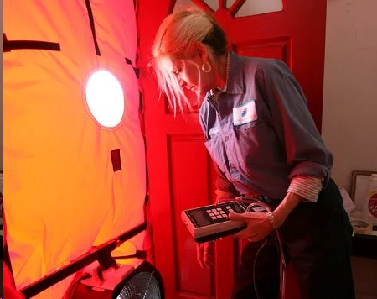
SPOTLIGHTS
Developing a diverse talent pipeline
California
Community outreach, education, and intake
SBP
Homeowner education
Sustainability Institute
Entry level weatherization services
AmeriCorps NCCC
Ampact
Communication/coordination/Workforce Dev. Support
VISTA - Maine
13
Notes:
(Brent)
Job shodowing etc.

Slide 14
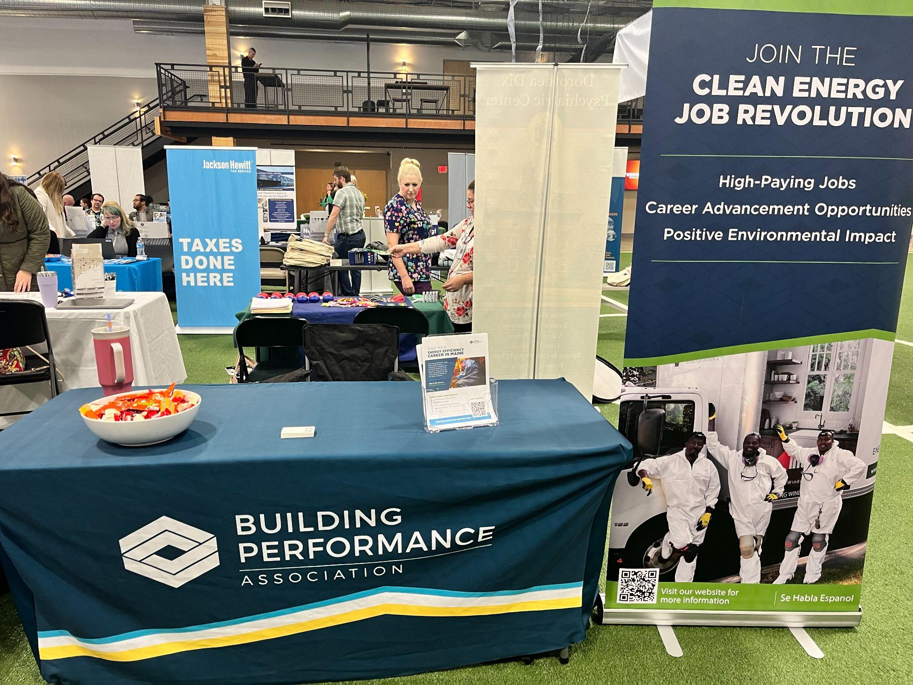
VISTA Responsibilities at BPA
Wraparound resource guide
Tabling at job fairs to connect with jobseekers and other employers
Reaching out to the community
Interviews with contractors on needs
Notes:
(Hailey) & turn over to Brent

Slide 15
NEW OPPORTUNITY
15
Notes:
(Brent)

Slide 16
Energy Efficiency Opportunity Corps
With the help of the National Renewable Energy Laboratory, Service Year Alliance and the Building Performance Association have partnered to develop a grant proposal to support a national AmeriCorps program to support weatherization/clean energy initiatives
Increased opportunity to expand programming due to Congress’ and the white house’s recent investments in weatherization, energy efficiency, clean energy, and the American Climate Corps
16
Notes:
(Brent)
- Building off of Momentum in Maine

Slide 17
Initial Scope
Primary Objectives/Outcomes
Assist underrepresented populations and individuals who are unemployed/underemployed in securing weatherization careers
Increase the ability of partners to provide weatherization services to more qualified families
Proposed Member Service Activities
Workforce development and career navigation support to underrepresented, unemployed, and underemployed populations
Community outreach, engagement, education, and application assistance/follow-up support
Stakeholder engagement and coordination
Research, community engagement, data collection, and design support for pursuing/coordinating resources that would expand or enhance WAP programming
Assistance in establishing processes and systems needed to administer and enhance weatherization services
Potentially - Facilitating entry-level weatherization and retrofit services
17
Notes:
(Brent)

Slide 18
Initial Scope
BUILDING PERFORMANCE ASSOCIATION
ADDITIONAL SUPPORT PROVIDED
Corps Member Recruitment
Marketing materials/templates
National marketing/outreach efforts/postings
National applicant coordination
Initial onboarding and training
Corps Member Support
Infuse BPI Certifications
Monthly Virtual Corps Member Enrichment and Training
Corps member check-ins
PRIMARY RESPONSIBILITIES
Grant administration
Securing match/cost share
HR - Payroll/Benefits/Criminal History Checks/Onboarding Paperwork
Reporting and Compliance
Supervisor training and support
18
Notes:
(Brent)

Slide 19
Initial Scope
TARGET HOST SITES
Primary: State Weatherization or Energy Office
Secondary: WAP Subgrantees
Host Site Commitments
Local recruitment and Interviewing
Designate a supervisor
Attend BPA meetings and trainings
Interviewing
Supplemental onboarding/training
Mentorships/advice
Timesheet approval
Data reporting
Necessary space, supplies, and equipment
Cost share contribution
19
Notes:
(Brent)

Slide 20
Next Steps
Timeline
Submit application in January 2024
Receive “intent to fund” in May 2024
Launch program in September 2024
Input Survey
Not asking for any type of firm commitment at this time
Additional input on proposed service activities/areas of need
Term types that could be of most use/interest
Initial interest in serving as a host site
Ideal # of corps members
Staff capacity to provide recruitment/supervision support
Input on realistic cost share contribution ($12,000)
20
Notes:
(Brent)

Slide 21
Questions, Clarification or Feedback? (You can use the chat or raise your virtual hand)
Notes:
Xavier

Slide 22
Upcoming Conferences- Mark your calendars!
The Clean Energy for Homes Conference & Trade Show: February 13 – 14th (Saratoga Springs, NY)
Earn CEUs through BPA Earn continuing education credits whether you're attending a conference or reading articles in the BPA journal, through our allied organizations, including ASHI, BPI (including QCI, HHE, and EA), InterNACHI, NARI, and NATE.
2024 Home Performance Conference & Trade Show: April 8 – 11th (Minneapolis, MN)
22
Notes:
Xavier

Slide 23
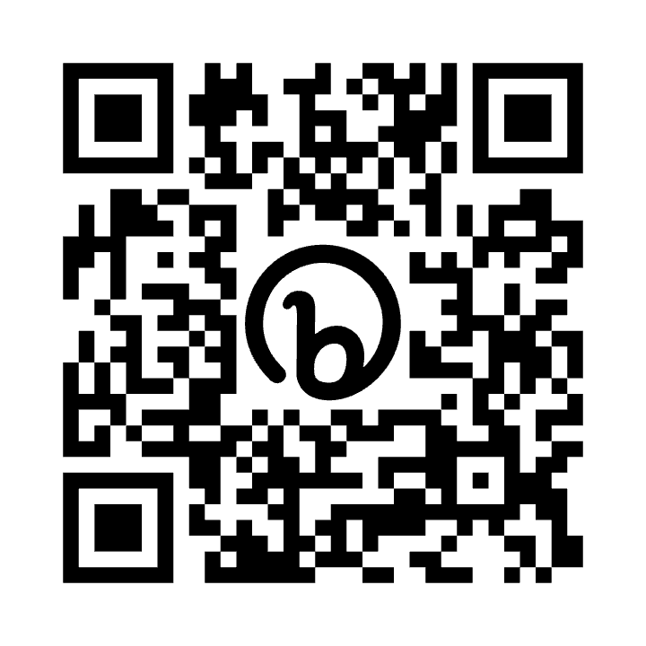
Contact information
Brook Vernon
bvernon@building-performance.org
412.314.4051
To sign-up for BPA's mailing list for all things home and building performance, please use the QR Code with your Smartphone!
www.building-performance.org/membership
Notes:
Xavier

Slide 24
Thank you!

