Slide 1


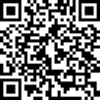
May 28-29, 2026 | Saratoga Springs, NY
Join energy professionals for two days of education and networking that will shape New York’s clean energy future.

