Slide 1
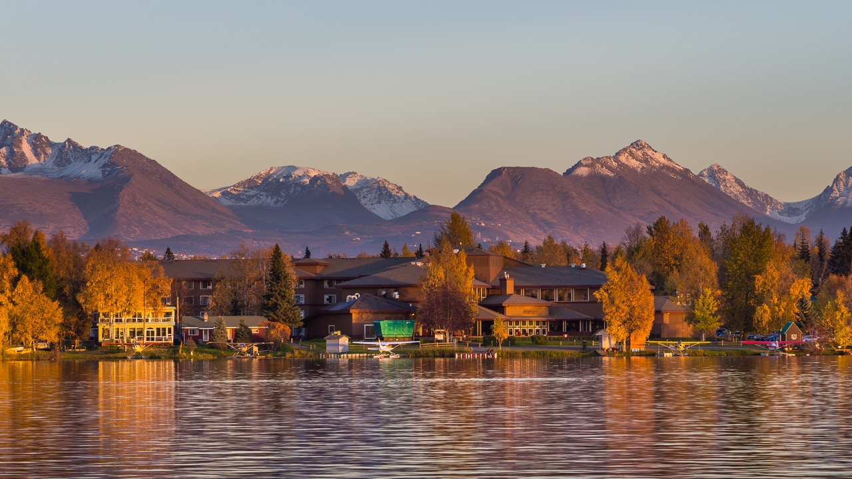


October 29-30, 2026 | Anchorage, AK
If you work in the Last Frontier, this is the event you’ve been waiting for.
We’re bringing together the industry’s top experts to deliver the education and insights specifically designed for your unique needs.

